Slide 1


The Disney Magic: Exploring the hidden layout
Since its opening in 1955, Disneyland has become the second most visited theme park in the world, right behind the Magic Kingdom at Walt Disney World.
However, this enormous and increasing popularity poses the problem of larger crowds and longer lines.
Improving crowd control and line efficiency have been of the utmost importance in maintaining high customer satisfaction, return rate, and ultimately the magical Disney experience.
Disney has seemingly contradictory goals, to both maximize the number of visitors, and therefore the profits, and maximize the number of park guests who leave with a satisfied smile on their faces.
With the efforts of industrial and systems engineers who specialize in process efficiency, Disney has mastered the art of optimization.

Slide 2
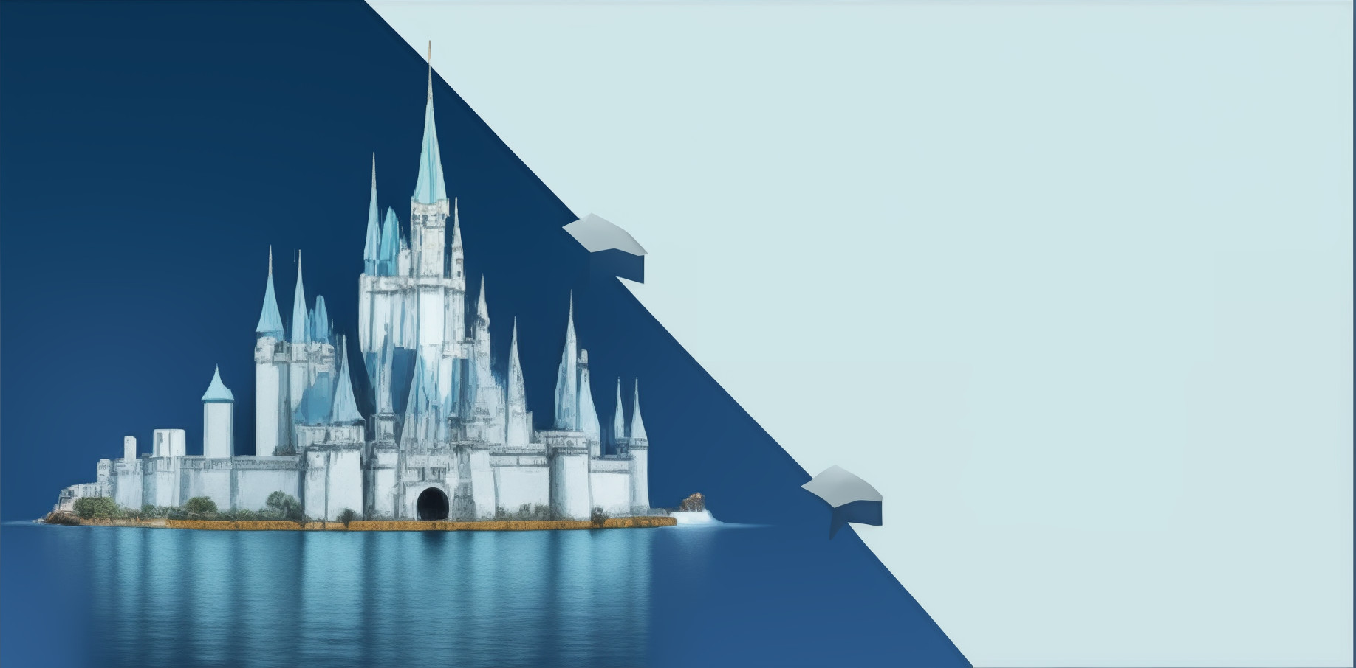
Purposeful Park Layout
Disneyland is divided into themed "lands," each with a signature attraction that attracts visitors.
Examples include Frontierland with Big Thunder Mountain, Tomorrowland with Space Mountain, and Adventureland with the Indiana Jones Adventure.
Placing major attractions at the far end of lands helps disperse crowds and avoid congestion.
Main Street's design facilitates smooth traffic flow into and out of the park.
The loop design encourages a steady flow of visitors and reduces congestion during peak times.

Slide 3
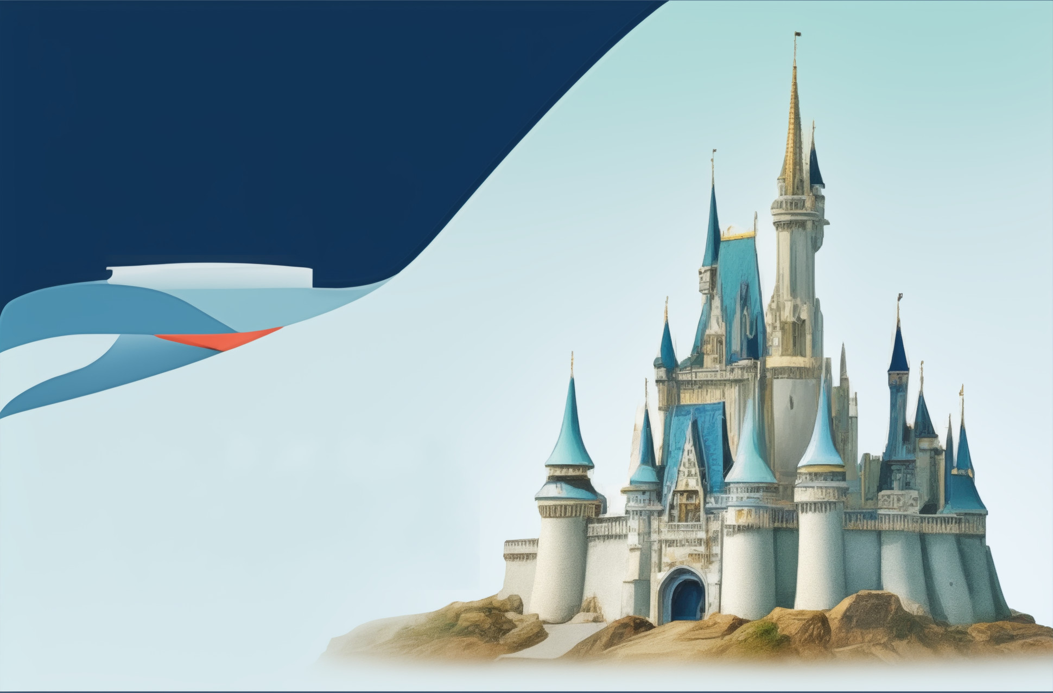
Storytelling and Immersion
Disney prioritizes storytelling to create an immersive experience for visitors.
Instead of just building rides, Disney Imagineers design entire lands that tell cohesive narratives.
Example: New Orleans Square transports visitors to the French Quarter through architecture, music, and costumes.
This commitment to storytelling sets a new standard for theme park design and enhances guest immersion.

Slide 4
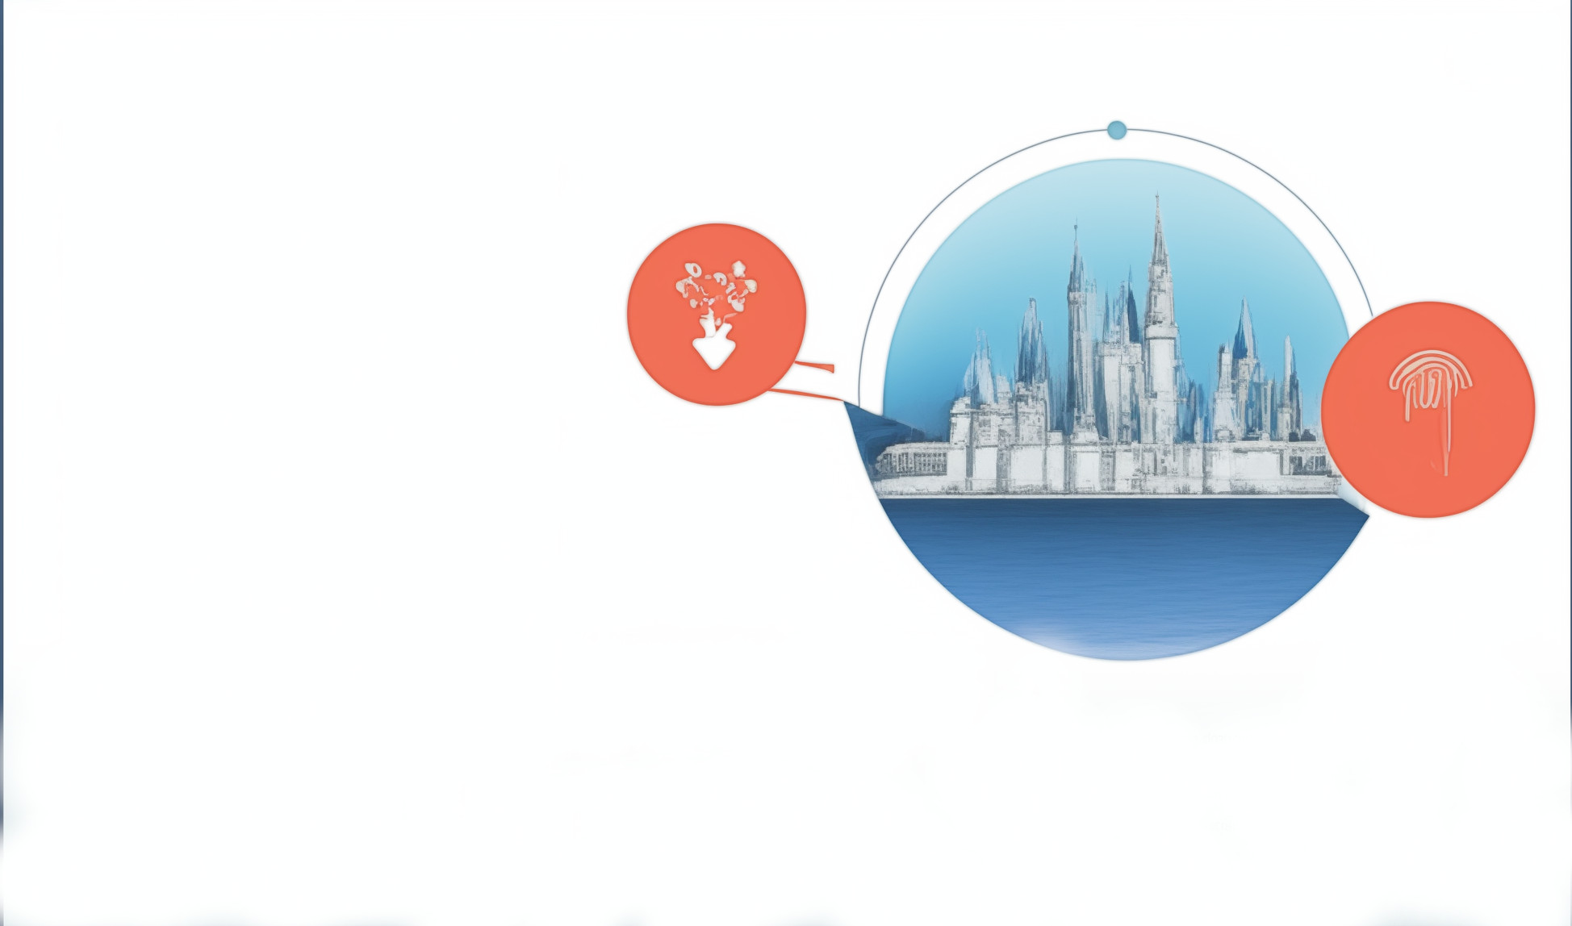
Architectural Techniques: Forced Perspective
Disney utilizes forced perspective, an ingenious architectural technique,
to create illusions of height and grandeur.
Structures are built with larger scales at the bottom and smaller scales at the top, enhancing their perceived size.
Example: Cinderella Castle appears much taller than its actual height of 189 feet due to forced perspective.
This optical illusion contributes to the immersive and larger-than-life feel of Disney parks, enhancing the overall guest experience.

Slide 5

Efficient Layouts and Navigation
Disney parks are designed with efficiency in mind to ensure smooth guest navigation and minimize congestion.
The hub-and-spoke layout design facilitates easy navigation, with themed lands branching out from iconic park landmarks at the center.
Guests can easily move between lands, enhancing their overall park experience.
Efficient layouts contribute to minimized wait times and optimized guest flow, ultimately enhancing guest satisfaction.

Slide 6
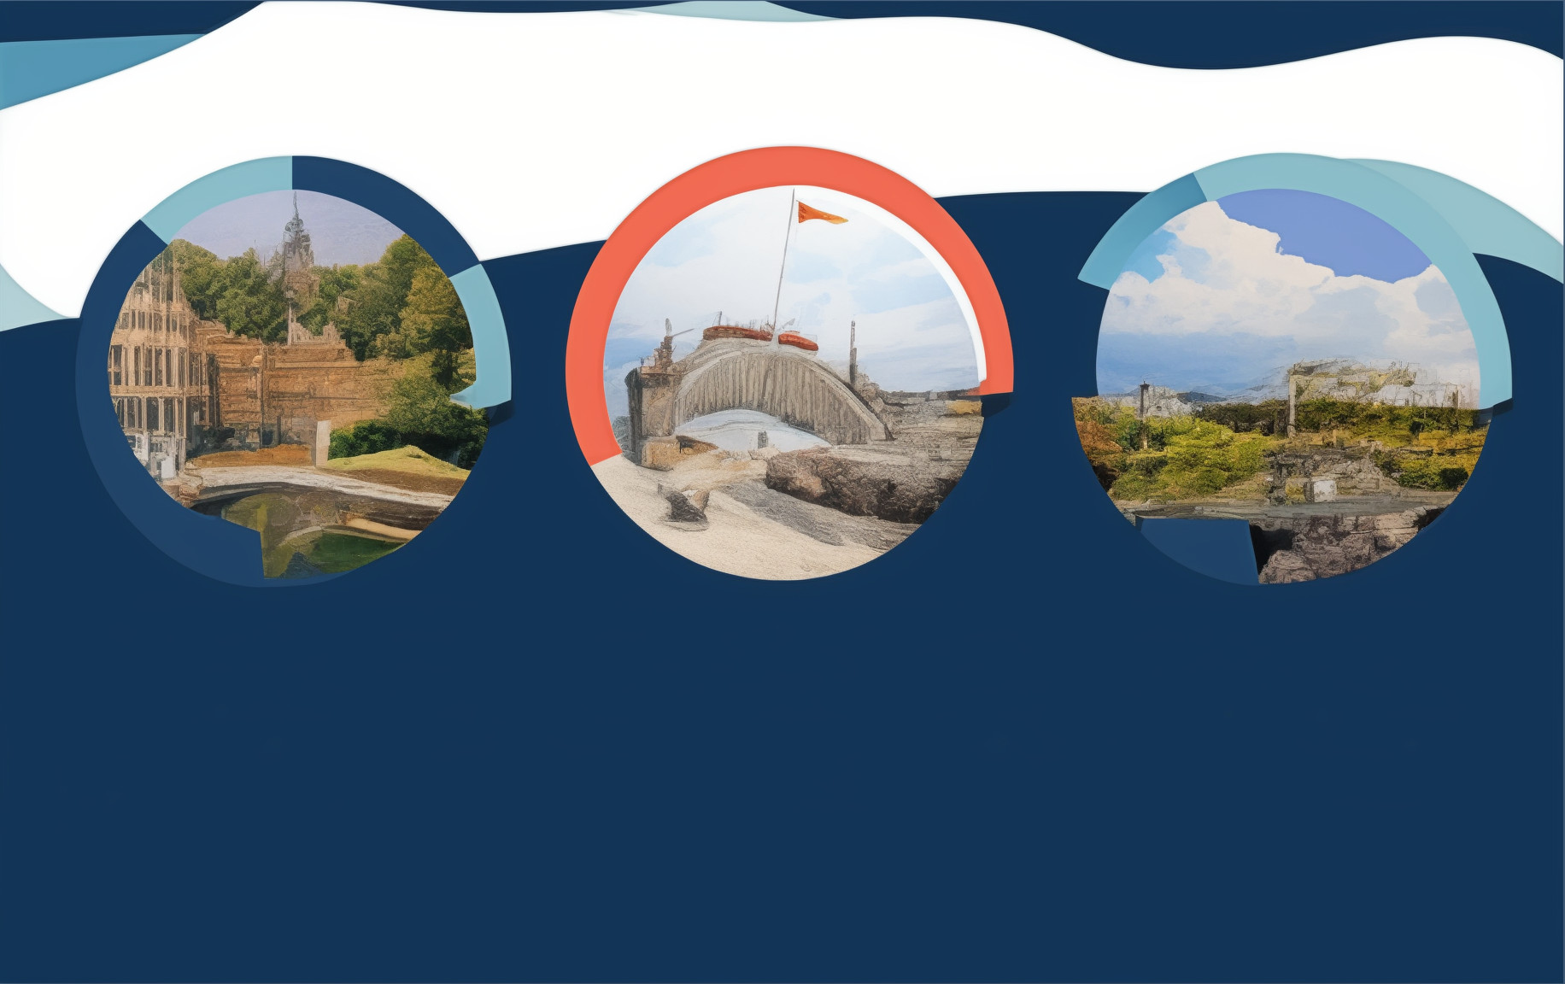
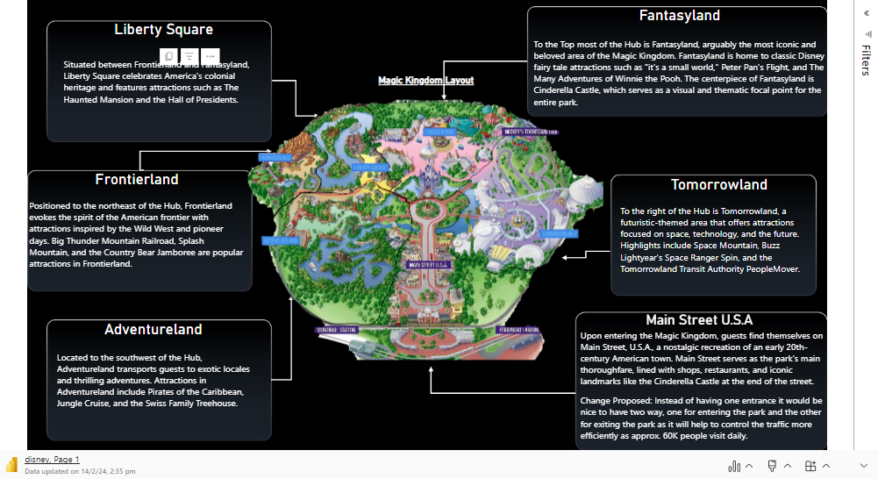

Slide 7
Conclusion
Disney parks are meticulously organized to facilitate a specific experience
for guests, guided by themed lands and strategically placed attractions.
The park layout reflects strategic business decisions aimed at enhancing guest satisfaction, maximizing revenue, and optimizing operational efficiency.
Key decisions include placing iconic attractions at the far ends of themed lands to encourage exploration and distribute crowds evenly throughout the park.
Efficient queue management strategies and high-capacity ride designs minimize wait times and enhance guest satisfaction.
These conclusions highlight the importance of Disney's approach to park design in driving guest satisfaction, repeat visitation, and financial success.

